Slide 1
P5 Drawing
{{ Xinyu Jiang}}
CSCI 3002 - Spring 2018 (Due: 1/23)

Slide 2
10 / 10
Points I have earned.
Enter your self-assessment of the points you’ve earned. The graders will verify this.

Slide 3

Emoji: Drawing (1 point)
{{ screenshot of the emoji drawing you created }}

Slide 4
Emoji: Source Code (1 point)
{{ URL to the online p5 document containing your source code }}
http://alpha.editor.p5js.org/Xinyu/sketches/rkuZdhzrM

Slide 5

Alexa Remote: Drawing (1 point)
{{ screenshot of the drawing you created }}

Slide 6
Alexa Remote: Source Code (1 point)
{{ URL to the online p5 document containing your source code }}
http://alpha.editor.p5js.org/Xinyu/sketches/Bk62i3zrf

Slide 7
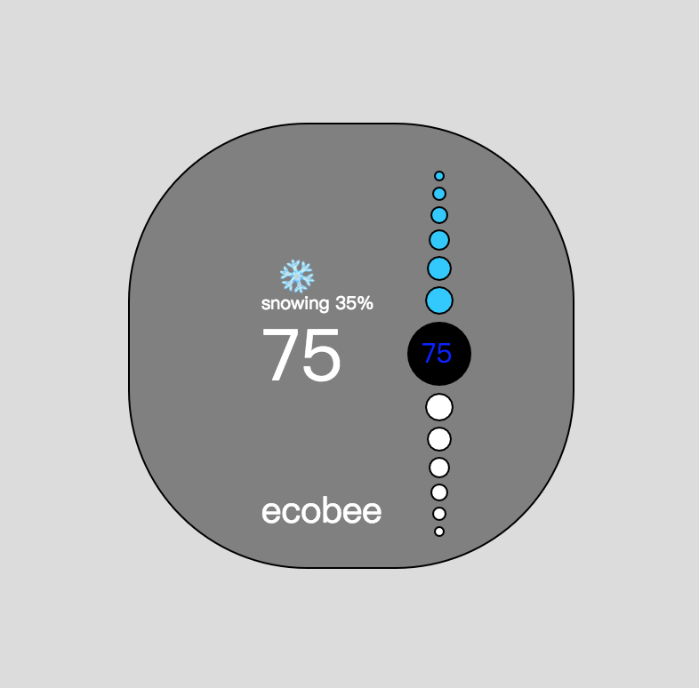
Ecobee Thermostat: Drawing (2 points)
{{ screenshot of the drawing you created }}

Slide 8
Ecobee Thermostat: Source Code (1 point)
{{ URL to the online p5 document containing your source code }}
http://alpha.editor.p5js.org/Xinyu/sketches/Hy5UreXHG

Slide 9
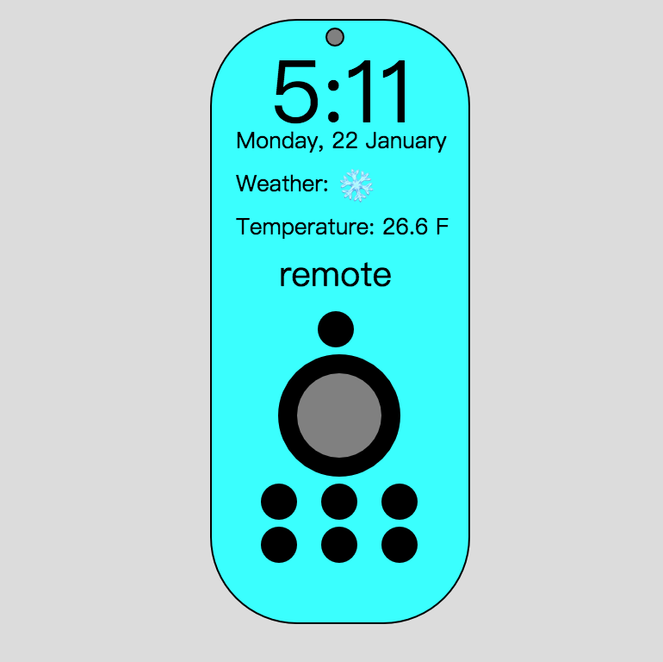
Hybrid UI: Drawing (2 points)
{{ screenshot of the drawing you created }}

Slide 10
Hybrid UI: Source Code (1 point)
{{ URL to the online p5 document containing your source code }}
http://alpha.editor.p5js.org/Xinyu/sketches/H1aQSWVSz

